Slide 1

Epidemiology and Outbreak
Virtual lab

Slide 2
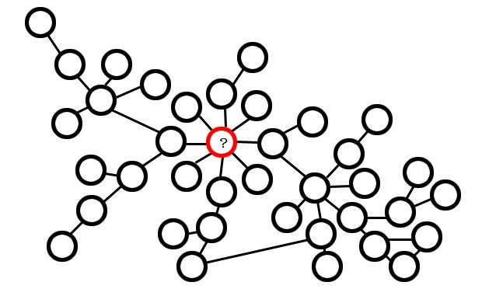
Epidemiology: study of the frequency and geographic distribution of disease & health-related factors
What do epidemiologists do in practice?
Surveillance
collect, analyze, & report data on rates of occurrence, mortality, morbidity and transmission of infections
Prediction
Build mathematical models that describe how a disease organism spreads through a population
Prevention and Intervention
Determine which diseases are “Reportable”, that is diseases that must be reported to state health depts, who then send quarterly reports to CDC (flu, measles are examples)

Slide 3
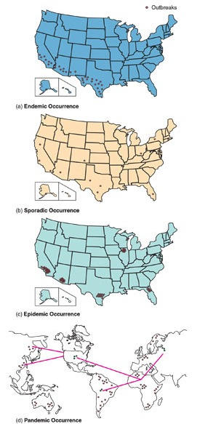
Epidemiology terms to describe geographic patterns of disease
Endemic
disease that exhibits a relatively steady frequency over a long period of time in a particular geographic locale. (Ex. Lyme disease in RI)
Sporadic
Disease that happen occasionally, with cases reported at irregular intervals.
Epidemic
Disease whose prevalence increases beyond what is normally expected for an area at a particular time. This may happen seasonally (e.g. the flu), or more rarely (e.g. measles)
Pandemic
epidemic that spreads across continents and around the world

Slide 4
Mathematical modeling of disease spread
When a person is infected, they pass it on to at least one other individual
R_{o} (read: R-naught or R-zero) represents the average number of new cases of infection generated by a sick or infective individual in a susceptible population. It is calculated using the formula below, where:
S is the size of the susceptible population
L is the length of infection, or time in during which the individual can pass on the pathogen
Transmissibility (β): is a number describing how readily the pathogen is passed from a sick to a healthy individual
R_{o} = S*L* β
Note that R_{o} does not tell you how fast a pathogen will spread!

Slide 5
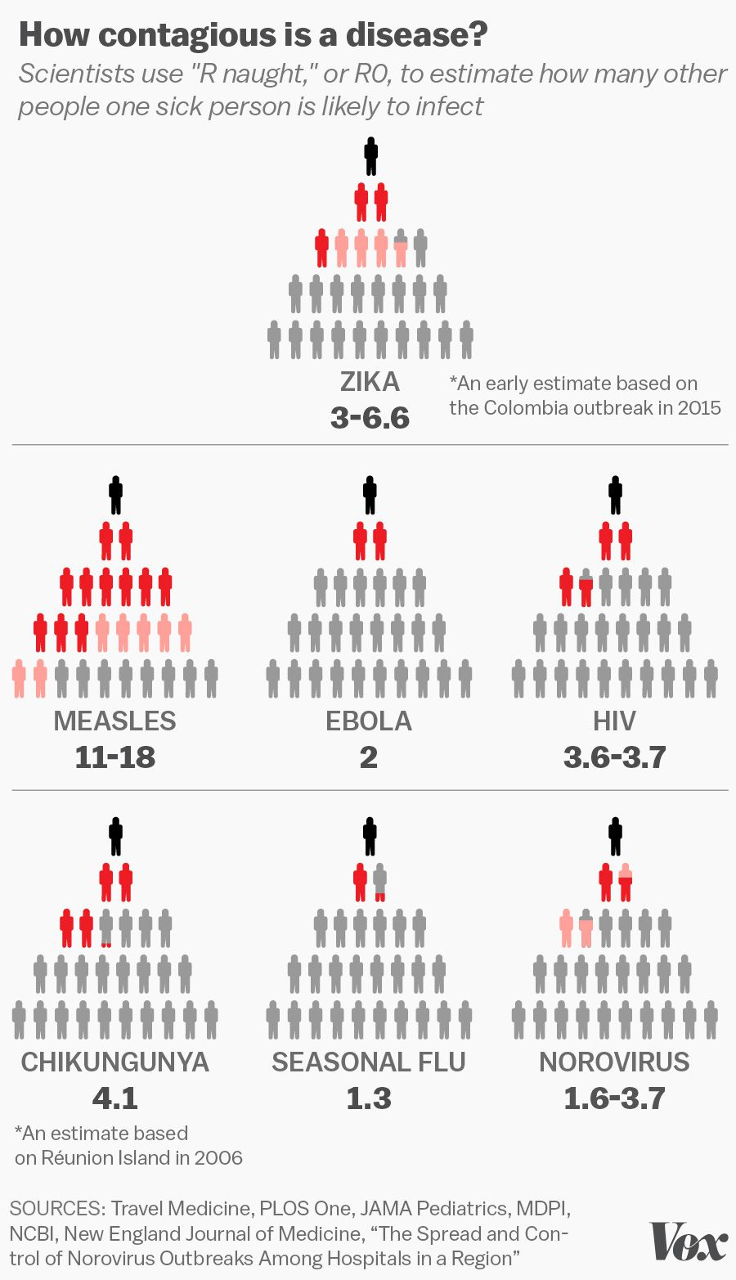
Important (and simple) conclusions from R_{o}
When
R₀ < 1
the infection will die out in the long run
But if
R₀ > 1
the infection will be able to spread in a population and increase over time
Generally, the larger the value of R₀, the harder it is to control the epidemic

Slide 6
Comparison of R_{o} values
Disease | Reproduction number R0
Ebola, 2014 | 1.51 to 2.53
H1N1 Influenza, 2009 | 1.46 to 1.48
Seasonal Influenza | 2 to 3
Measles | 12 to 18
MERS | around 1
Polio | 5 to 7
SARS | <1 to 2.75
Smallpox | 5 to 7
Wuhan Coronavirus 2019-nCoV | 1.4 to 4.08

Slide 7
Modeling disease spread
Network models
Are an approach to describing spreading processes such as epidemics or information transfer in populations
Nodes represent individuals (circles)
Edges represent interactions between individuals that could potentially lead to transmission of infection (lines)
Through tracing contacts backward in time, it could show who patient zero was (? In the red circle). This is useful to understand how the outbreak began in the first place, and is essential in devising strategies to prevent or mininmize the risk of future outbreaks

Slide 8
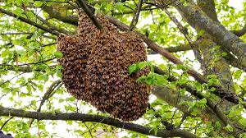
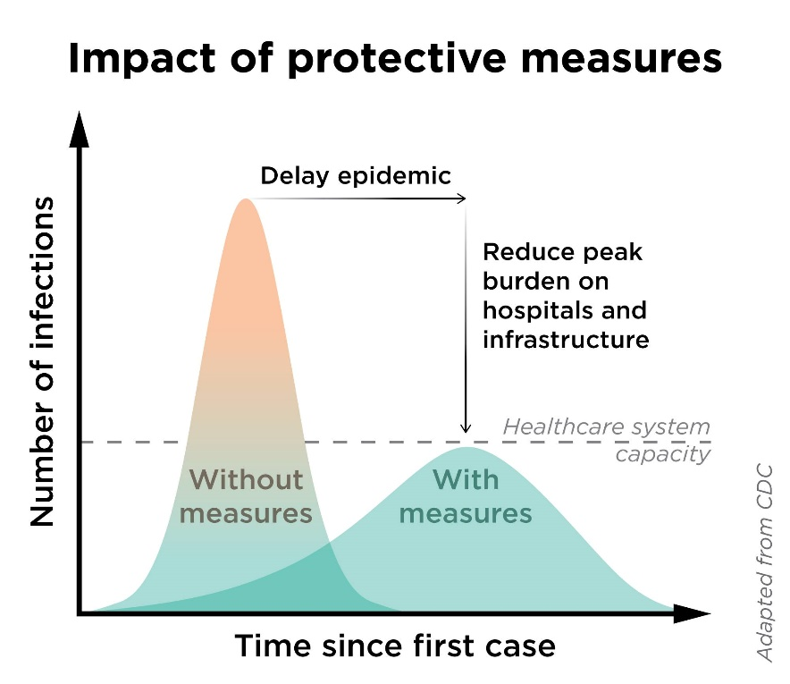
Stop the spread! Important terminology
Isolation
Population that HAS the disease is physically isolated until healthy again.
Quarantine
Population that is EXPOSED is physically isolated for the estimated incubation time. In the case of COVID-19, it’s about 2 weeks
Social distancing
Isolating to decrease the spread, especially effective for diseases that spread on cough droplets (like Coronavirus, flu, measles)
Personal protection when the mechanism of spread is understood, personal protection can help enormously to slow down the spread of a disease and reduce the r₀. Face masks have been shown to be very effective with COVID-19, because it spreads mainly through breath droplets. Other diseases require completely different protection. Find an example different from COVID
Flattening the curve
Refers to reducing the rate of emergence of new cases. This reduces the burden on hospitals to a manageable load. Think of it as spreading the cases over time. If you assume that once the pathogen is out all susceptible individuals will eventually get it, how can you slow the spread to a level that the health care system can handle? Compare the two curves at the right.
The “measures” used are social distancing, quarantine, isolation

Slide 9
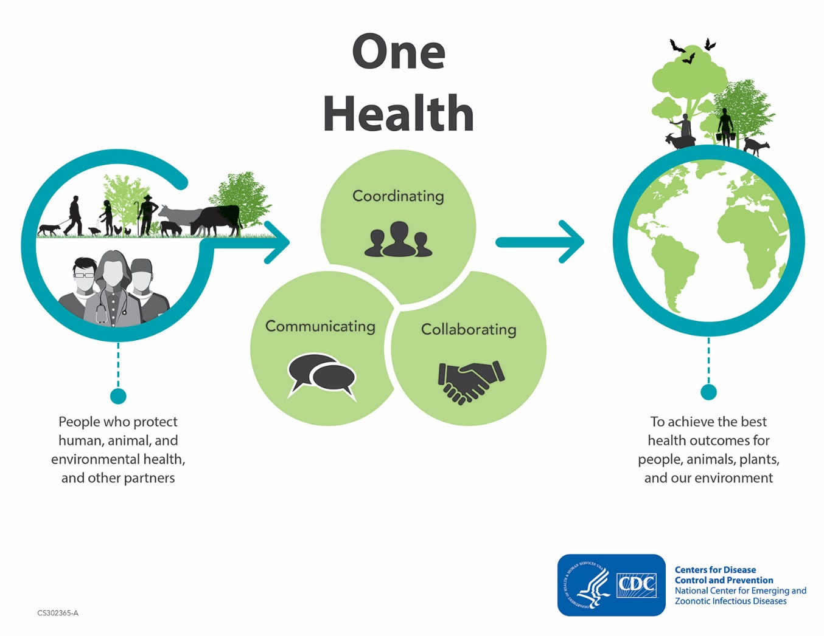
One Health-a comprehensive way to look at disease management
60% of human infectious diseases have come from animals
We are a spillover species
One Health recognizes that the health of people is connected to the health of animals and the environment
collaborative, multisectoral, and transdisciplinary approach
goal of achieving optimal health outcomes recognizing the interconnection between people, animals, plants, and their shared environment
A One Health approach is important because 6 out of every 10 infectious diseases in humans are spread from animals. I
Dilution hypothesis
As biodiversity decrease, the probability increase that a disease will spill onto us rather than another animal
Biodiversity IS the protector!

Slide 10
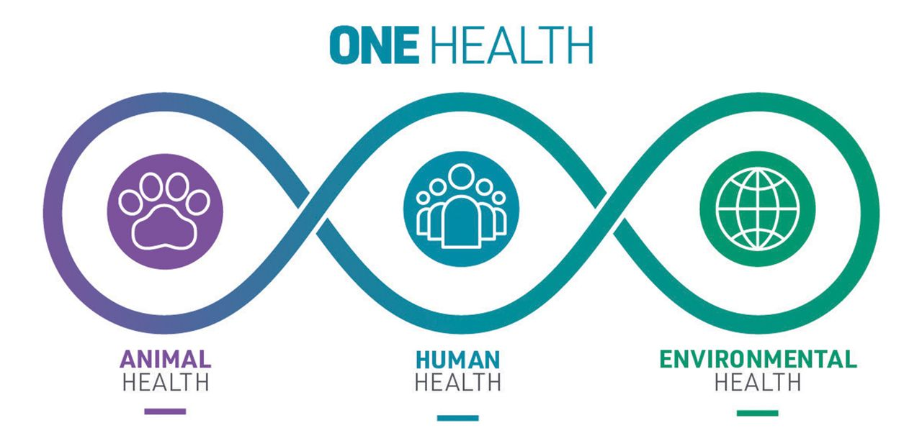
Factors that Affect Human and Animal Health
Factor (Cause) | Change (Effect)
Human populations are growing and expanding into new geographic areas. | As a result, more people live in close contact with wild and domestic animals. Close contact provides more opportunities for diseases to pass between animals and people.
The earth has experienced changes in climate and land use, such as deforestation and intensive farming practices. | Disruptions in environmental conditions and habitats provide new opportunities for diseases to pass to new animals and then to people.
International travel and trade have increased. | As a result, diseases can spread quickly across the globe.

Slide 11
Curing viral infections
As you learned lecture before the break, viruses are made of only a capsid, a genome, and sometimes an envelope. They cannot reproduce or metabolize by themselves and must parasitize a cell to carry out their life cycle.
This is why there are very few antiviral drugs! Since the virus exploits the cell’s machinery, any drug that interferes with viral replication will very likely interefere with the life of normal, uninfected cells.
Can we take antibiotics? No! Antibiotics kill bacteria and some of them fungi. All of which are cells. They won’t do anything against a virus.
In the long term, what’s our best defense, then? Coming up with a vaccine. That will allow people’s immune system to be “trained” to fight the virus, without going through the disease process.

Slide 12
First Assignment:
Go to the CDC’s Solve the Outbreak simulation
https://www.cdc.gov/mobile/applications/sto/
Select “Level 1”
Complete two of the games.
Answer the questions in your lab report – must be typed and saved!!!!!

Slide 13
Second assignment:
Visit the following website:
http://vax.herokuapp.com/
Tour the game
Complete each of the lessons
Play the full game
Select the “Easy” mode
Answer the questions in your lab report – must be typed and saved!!!!!

Slide 14
Third assignment:
Read the following article:
https://www.washingtonpost.com/graphics/2020/world/corona-simulator/?itid=hp_hp-top-table-main_virus-simulator520pm%3Ahomepage%2Fstory-ans
Answer the questions in your lab report – must be typed and saved!!!!!

